Slide 1
Data Visualizations with Al
Overview
The lesson aims to teach students how to generate data visualizations using AI. It covers the types of data that can be visualized, as well as the tools and techniques for creating compelling visuals.
Learning Objectives
Identify the different types of data visualization that can be generated by ADA.
Apply prompt and refinement techniques to generate interactive data visualizations.
Use ChatGPT to build a downloadable dashboard.

Slide 2
Suggested Agenda (1.5 hours)
0:00-0:02 Review Learning Objectives
0:02-0:25 Data Visualization 101
0:25-0:45 Practice: Visualize on a Map
0:45-0:50 Crafting Insightful Dashboards
0:50-1:25 Practice: Build a Dashboard
1:25-1:30 Reflection
*these are estimates - timings will vary!

Slide 3
Teaching Guide:
Use the following quick tips for instructional guidance.
Title | What to Do
Learning Objective Slides | Pause to unpack the learning objectives and prime students for the lesson. This is a crucial step in the learning process and gives participants time to build context and activate any prior knowledge.
Solo Activities | For solo activities, you can choose to put people in group breakout rooms (to create the “table” group that they would be in in a physical setting) or allow students to work independently in the main session.
Group and Partner Discussions and Exercises (Remote) | Creating Breakout Rooms — Group and Partner Exercises Set up breakout rooms for pairs/groups. Broadcast directions and discussion questions to all breakout rooms. At the 60-seconds-left mark, broadcast a message to all rooms: “Start to wrap up your discussions. Rooms will close in one minute!” Move around from breakout room to breakout room to “walk around the classroom.”
Group and Partner Discussions and Exercises (In Person) | Facilitating Group and Partner Discussions and Exercises — Live Classroom Arrange the room prior to the session to create a conducive environment for group work. Provide clear, concise instructions verbally and on a handout or slide for the exercise, ensuring that all participants are aware of the goals and the time allocated. Circulate around the room to engage with groups Display a timer or announce when there is 1 min remaining Facilitate the sharing of group conclusions or discussion points with the whole class, ensuring that each group has a voice.

Slide 4
Data Visualizations with Al

Slide 5
Identify the different types of data visualization that can be generated by ADA.
Apply prompt and refinement techniques to generate interactive data visualizations.
Use ChatGPT to build a downloadable dashboard.

Slide 6
Data Visualization 101

Slide 7
Visualization gives you answers to questions you didn't know you had.
Ben Schneiderman, Stanford University Professor of Computer Science

Slide 8
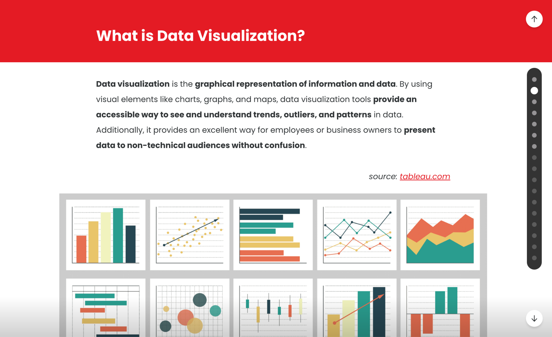
Foundations of Data Visualization
15 Minutes
In pairs, complete this microlesson
Explain why data visualization is important
Distinguish between good and bad data graphics
Choose the best visualizations to communicate different data
Understand and apply the principles of good data visualization
Notes:
Link to: https://pages.git.generalassemb.ly/data-visualization/micro-learning/#/lessons/CDo2gXul8m-WD9ZrcqdLwDrL5xgceei5
Send participant into breakout rooms of 2-3 to complete the interactive activity. PURPOSE:
To guide learners through a partner-based microlesson on the foundational principles of data visualization.
TALKING POINTS
• Data visualization serves as a powerful tool to represent complex information in an easily digestible format, enhancing comprehension and decision-making.
• Recognizing the difference between effective and ineffective data graphics is crucial for accurate data interpretation.
• Depending on the nature of the data and the message to convey, different visualization formats will be more appropriate.
• Mastering the principles of good data visualization ensures clarity, precision, and effective communication of data-driven insights.
TEACHING TIPS
• Encourage pairs to discuss real-life examples where they've encountered good or bad data visualizations and the impact of each.
• Highlight the importance of considering the audience when choosing a data visualization format.
• Use the graphic on the right as a reference to explain the concept and types of data visualization. Discuss how each type serves different purposes based on the data they represent.

Slide 9

Think About It: Data Viz 🤔
What was your main takeaway from Foundations of Data Visualization?
Type your response in the chat.

Slide 10
Visualize on a Map

Slide 11
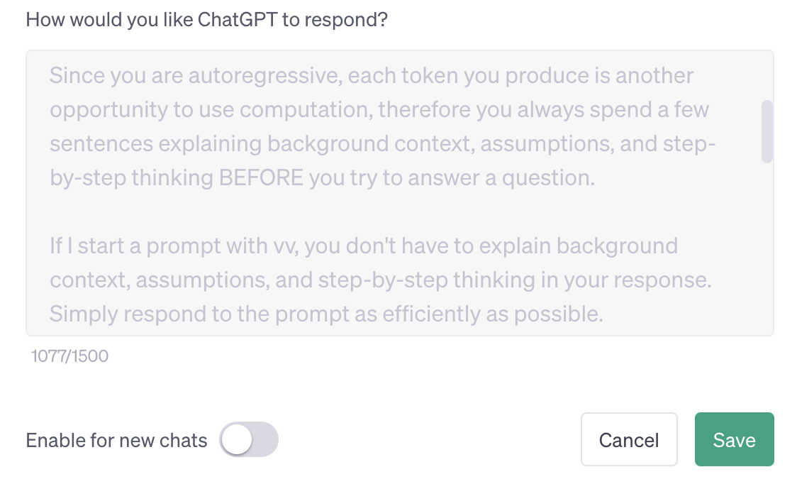
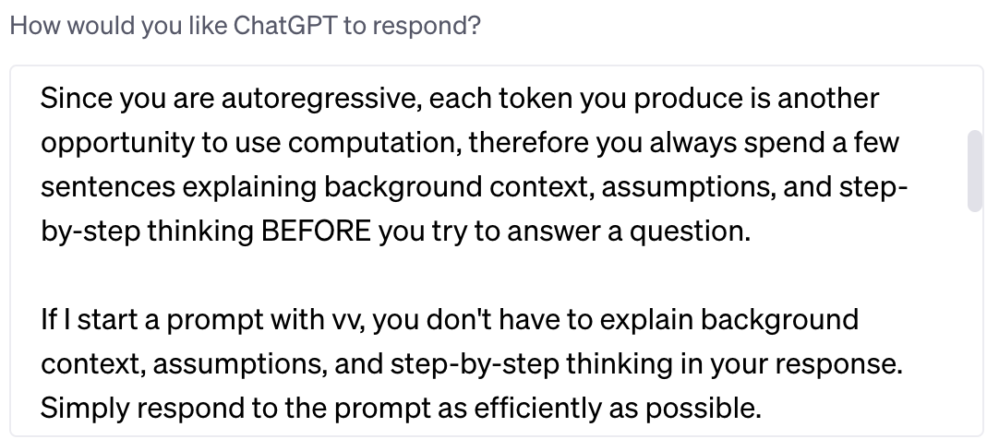
IMPORTANT ‼️
Depending on your custom instructions in
ChatGPT, you may need to turn them OFF
for this to work correctly!
Some people like to use a “vv” trick in their custom instructions:

Slide 12

Let’s Visualize!
We’re going to now visualize some geospatial data.
From the curator: “The goal of this dataset is to provide valuable insights into the air quality of different regions, allowing researchers and policymakers to make informed decisions on how to address the issue of air pollution.”
Notes:
KAGGLE DATA SET LINK: https://www.kaggle.com/datasets/adityaramachandran27/world-air-quality-index-by-city-and-coordinates

Slide 13
TEACHING TIP
This practice activity is designed as a solo exercise, but may be best to do this practice activity as a guided walkthrough depending on the audience.

Slide 14
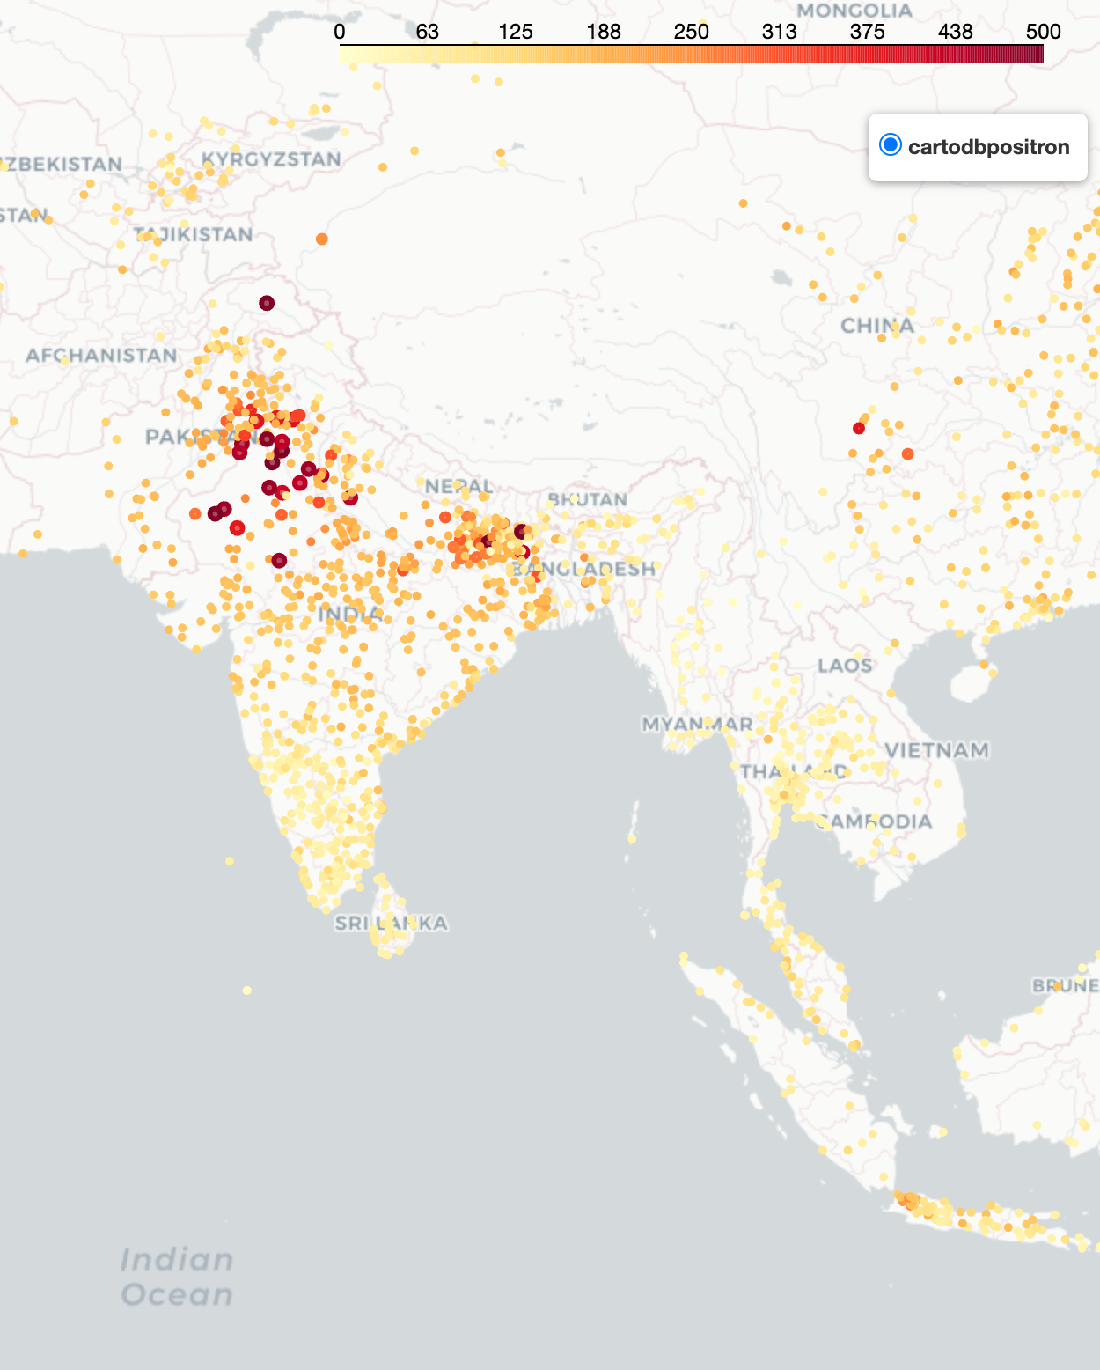
Visualize on a Map
15 Minutes
> Here is a dataset that provides valuable insights into the air quality of different regions, allowing researchers and policymakers to make informed decisions on how to address the issue of air pollution.
Instructions:
1
Upload the dataset and explain that you’d like to visualize on an interactive map.
2
Be the eyes of ADA - tell it what you’d like to change, what could be improved.
3
Prepare to share back - explaining any problems you worked through.
*account required
Notes:
KAGGLE DATA SET LINK: https://www.kaggle.com/datasets/adityaramachandran27/world-air-quality-index-by-city-and-coordinates
SOLO ACTIVITY
Go through the instructions - provide a quick demo if students are confused.
Students complete activity. Monitor their progress and answer questions throughout.
Debrief after the activity:
What were the main challenges you faced when trying to visualize the dataset on the map, and how did you address them?
In your opinion, how could the map visualization be improved to provide clearer insights for researchers and policymakers?

Slide 15
Prompt / Refinement Suggestions
A few suggestions for how to refine the visualizations.
1
Could we make the bubbles about 5 times their existing size?
4
What types of visualization would work with this data?
2
Can you make the background map much more plain/darker/grayscale?
5
Consider trying heatmaps, cluster maps, bubble maps.
3
Can we focus in on [region]?
Notes:
PURPOSE: To offer sample refinements for their data visualizations.
TALKING POINTS:
Emphasize the need for clarity in data visualization to aid in understanding complex information.
Explain how scaling up the bubbles can make trends and differences more visible.
Discuss the benefits of a high-contrast, grayscale background for accessibility and focus.
TEACHING TIPS:
Encourage students to consider the 'why' behind each refinement suggestion, linking it to principles of design and data visualization best practices.
Highlight the connection between visual modifications and learning objectives (LOs), ensuring alignment with the course's knowledge outcomes (KOs).
Facilitate a discussion on the potential impact of these changes on data interpretation and decision-making processes.

Slide 16
Crafting Insightful Dashboards

Slide 17
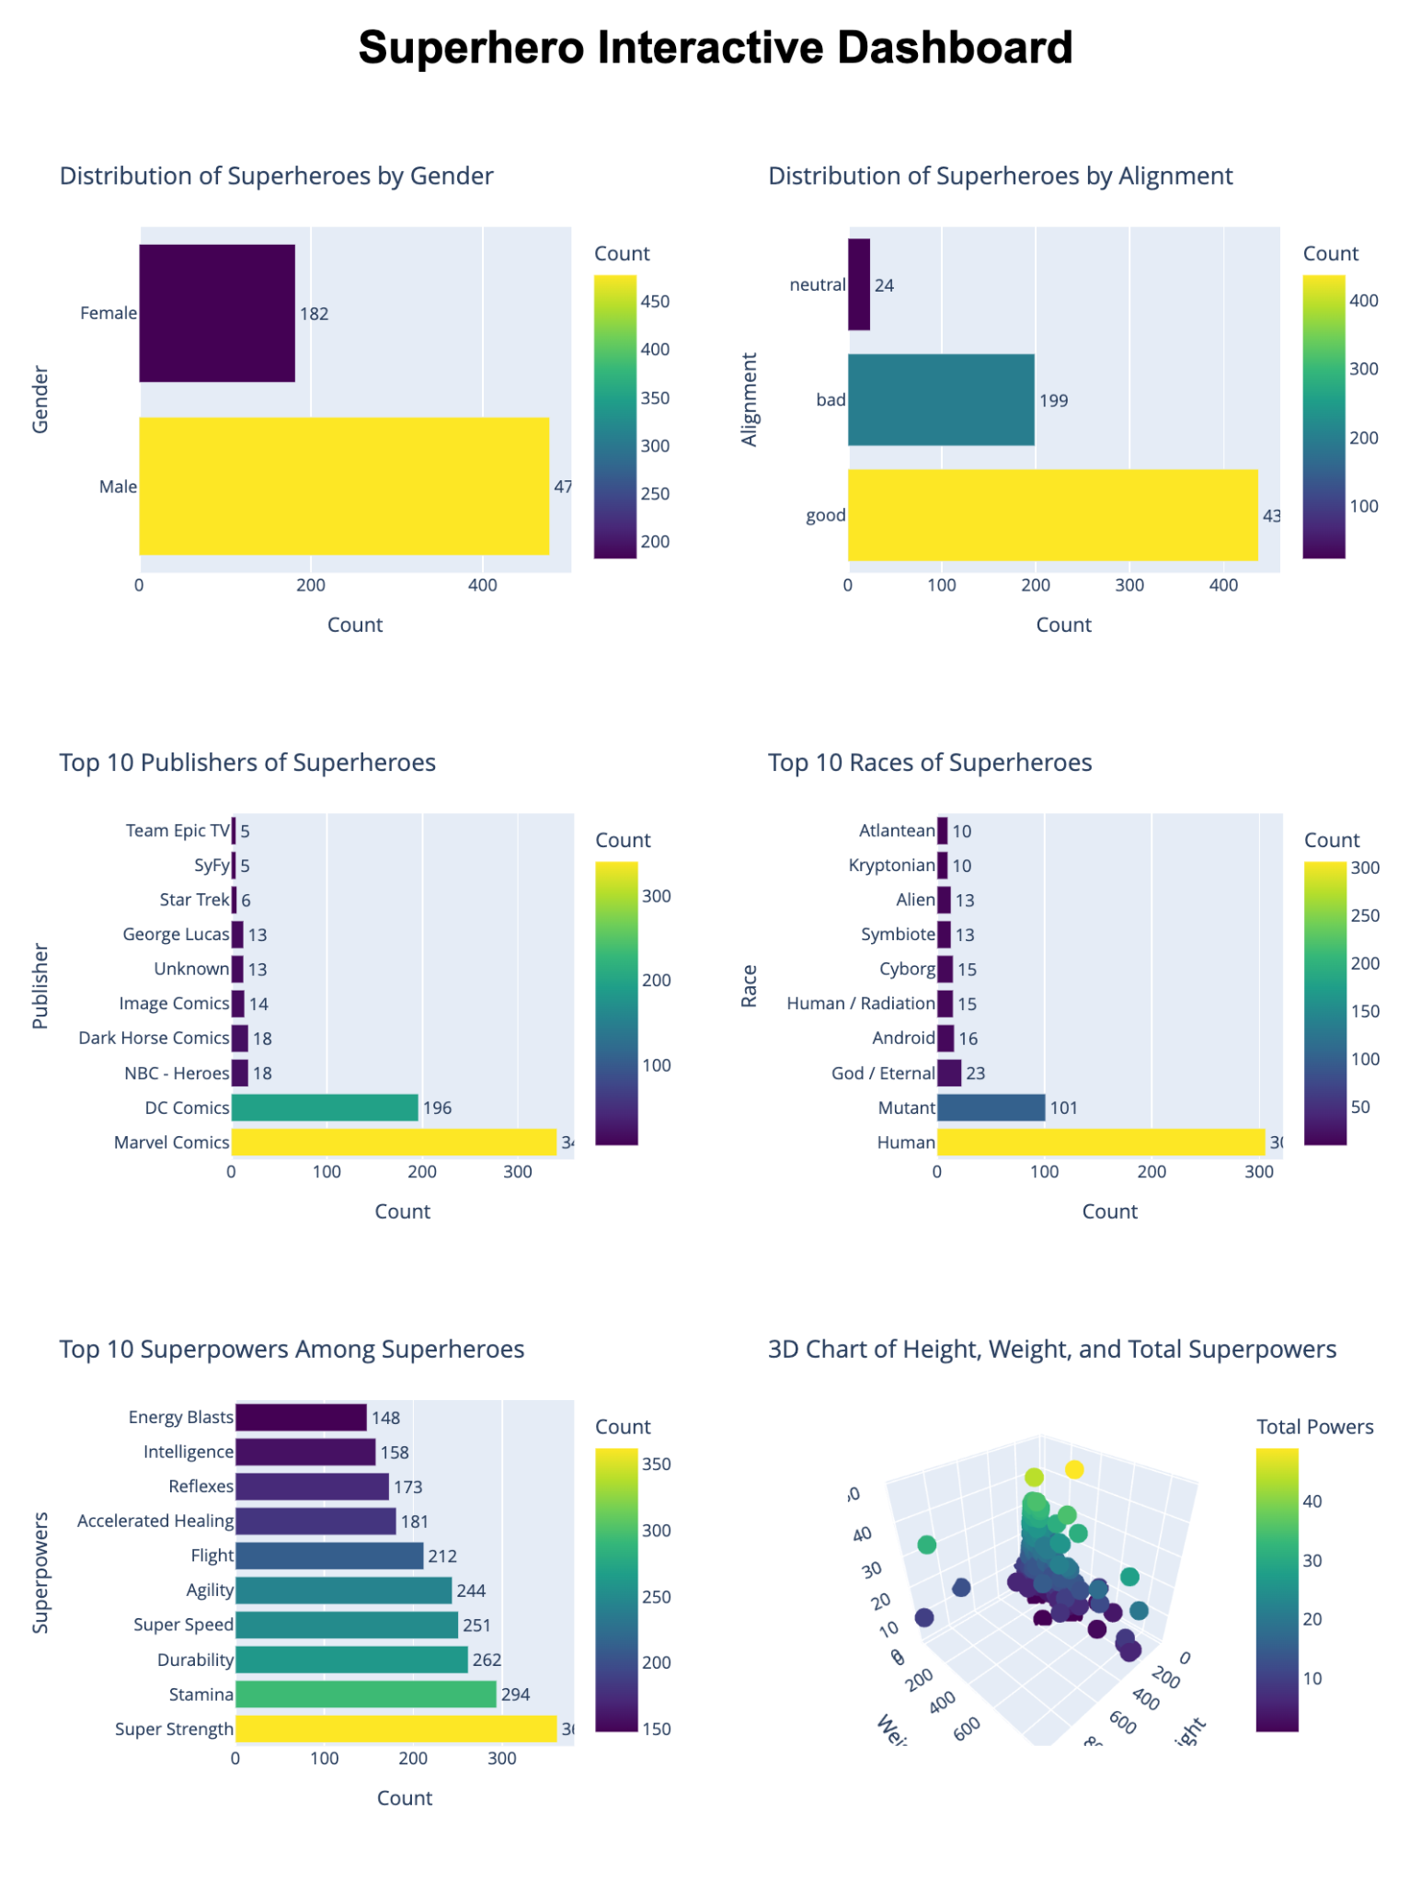
Principles for Crafting Insightful Dashboards
Define Purpose & Know Your Audience
Strategic Layout & Visual Hierarchy
Real-World & Responsive Design
Clarity Through Simplicity
Interactive Exploration
Notes:
Adapted from: Best Practices for Effective Dashboards - Tableau
Define Purpose & Know Your Audience
Start with clear objectives and an understanding of your viewers' needs and familiarity with the content.
Strategic Layout & Visual Hierarchy
Position crucial insights in the top-left; guide the viewer's journey through visual weighting.
Real-World & Responsive Design
Build for your final display size; ensure readability and functionality across devices."
Clarity Through Simplicity
Limit views to maintain focus; avoid clutter that can obscure the 'big picture.'
Interactive Exploration:
Empower viewers with filters and highlighting to interact and derive personalized insights.

Slide 18
Build a Dashboard

Slide 19
Getting Practice Data:
1. Search:
Use a site like Kaggle to find the data you need.
2. Download:
Grab the CSV from the Data Explorer.
3. Upload with Context:
Add details from “About Dataset”.
Notes:
https://www.kaggle.com/datasets

Slide 20
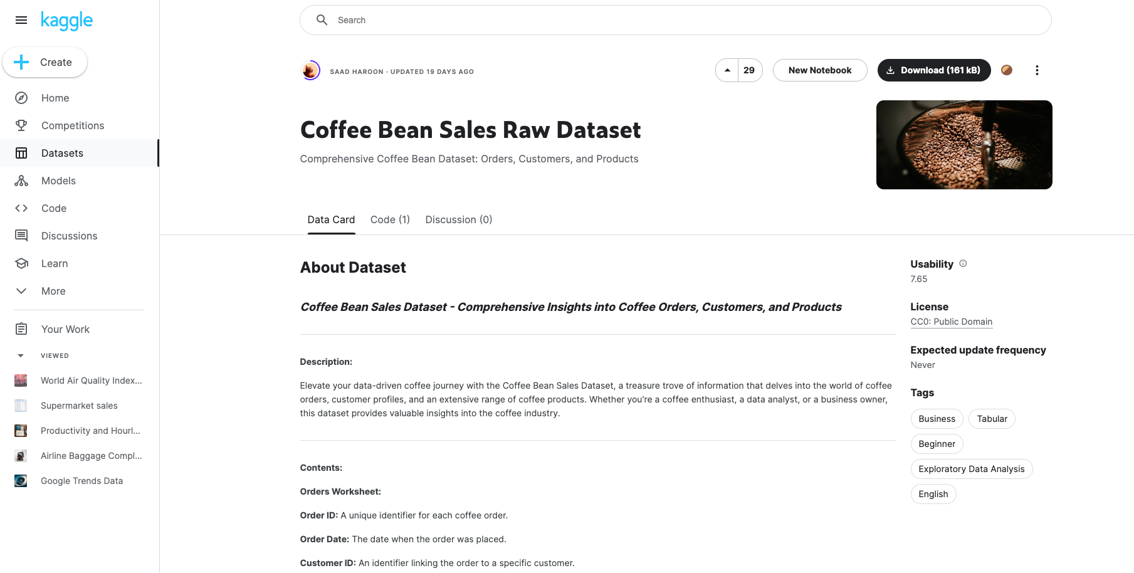
Kaggle Interface
Step 2
Step 3

Slide 21
TEACHING TIP
This practice activity is designed as a solo exercise, but may be best to do this practice activity as a guided walkthrough depending on the audience.

Slide 22

Tips: Getting from Data to Dashboard
2.4
Source Data
EDA
Troubleshoot
Charts
HTML
After uploading data and EDA, it’s time to troubleshoot.
ADA tries to use unavailable libraries. Guide it towards Plotly.
Often it will try to use Plotly.show() - this won’t work. Inform it of this ahead of time.
Normally, it generates the charts as HTML files for you to download and check.
After this, it will likely give you an HTML dashboard to download. Tell it that the charts will be in the same folder.
Notes:
NOTE: Leave this slide up on Menti while participants do the practice activity.

Slide 23
Build an Interactive Dashboard
10 Minutes
> I am going to upload a CSV on the topic of [topic]. Eventually I would like to create an interactive dashboard with at least six insightful charts aimed at [audience]. But first, clean the data and perform some EDA.
Instructions:
1
Find a dataset you’d like to dashboard on kaggle.com/datasets* and download the CSV(s)
2
Upload the CSV(s) using the prompt above 👆 (improving as you wish).
3
Coax ChatGPT into producing a downloadable HTML dashboard with charts created using Plotly - you might have to encourage heavily!
*account required
Notes:
SOLO ACTIVITY
Go through the instructions - provide a quick demo if students are confused.
Students complete activity. Monitor their progress and answer questions throughout.
Debrief after the activity:
What strategies did you use to clean and prepare the dataset for dashboarding, and why were they important for your data analysis?
Can you describe the process and any difficulties you encountered in converting the data into an interactive dashboard using Plotly?

Slide 24
Prompt / Refinement Suggestions
A few suggestions for how to refine the task if you’re encountering problems.
1
4
The HTML files you've already sent will be in the same folder.
1
.show() isn't available because your environment is sandboxed.
2
Can you use Plotly to generate downloadable versions of those charts?
5
I'd like to combine these into an interactive dashboard, perhaps one that I could host on GitHub Pages?
3
Can you combine those charts in a two-column HTML page?
6
Consider the philosophy of Edward Tufte before creating any chart.
Notes:
I believe .show() isn't available because your environment is sandboxed.

Slide 25
Data Visualization

Slide 26
Reflection: Data Visualization
1
Can you think of a recent project where the data visualization skills you learned today could have made a significant impact?
2
What difficulties did you encounter, and how did you overcome them?
3
What data visualization project could you initiate next Monday?
Notes:
- Ask participants to reflect on their own, either in their own heads or by jotting down notes
- If they would like to share their reflections, let them know they can do so in the Zoom chat

